Slide 1
Chapter: 1] Software Quality Assurance Fundamentals
Prof. Sachin Lende
MCA – II
Subject :- Software Testing & Quality Assurance

Slide 2
what is quality?
Quality from :-
A customer view point fit for use or other customer needs.
Producer’s viewpoint meeting requirements.
Software quality is defined as conformance to explicitly stated functional and nonfunctional requirements, explicitly documented development standards, and implicit characteristics that are expected of all professionally developed software

Slide 3
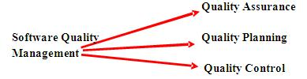

Slide 4
Quality Assurance:
Definition:
A planned and systematic pattern of all actions which is necessary to provide adequate confidence that material, data, supplies & services conform to established technical requirements and achieve satisfactory performance.
Quality assurance consist of a set of auditing and reporting functions that access the effectiveness of quality control activities.

Slide 5
Quality Control:
The definition & enactment of processes which ensures that the project quality procedures & standards are followed by the software development team.
QC activities are work product oriented. They measures the product The direct result of these activities are changes the product.

Slide 6
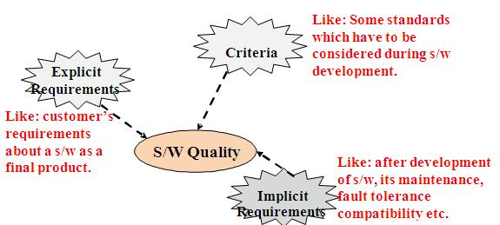

Slide 7
KEY DIFFERENCE
Quality Assurance is aimed to avoid the defect whereas Quality control is aimed to identify and fix the defects.
Quality Assurance provides assurance that quality requested will be achieved whereas Quality Control is a procedure that focuses on fulfilling the quality requested.
Quality Assurance is done in software development life cycle whereas Quality Control is done in software testing life cycle.
Quality Assurance is a proactive measure whereas Quality Control is a Reactive measure.
Quality Assurance requires the involvement of all team members whereas Quality Control needs only testing team.
Quality Assurance is performed before Quality Control

Slide 8
Quality Planning:
Selection of appropriate procedures and standards from the framework and the adoption of these procedures/standards for a specific software project.
Conformance to explicitly stated functional & performance requirements, explicitly documented development standards & implicit requirements, & is expected from all professionally developed software

Slide 9
1.2 SQA Planning & standards:
SQA plan provides a road map for SQA.
SQA Plan should include:
1. System Design Review
2. S/W requirements specification review
3. Preliminary design review
4. Detail design review (Module Level review)
5. Review of integration test plan
6. Code Review
7. Review of test procedures
8. Audit of document standards
9. Configuration Control Audit
10. Test Audit
11. Defect data collection, evaluation analysis
12. Tool certification
13. Vendor & contractor oversight
14. Record keeping

Slide 10
Product Standard | Process Standard
1. These are the standard that applies to S/W product being developed. | 1. They include specific process activity which assures that the product standards are followed.
2. Include documentation standards (related to structure) and coding standards (Programming features). | 2. Used during the s/w development and includes: definition of specifications, design & validation process + description of documents which is generated during process.
3. Applied to s/w process o/p. | 3. Applied on process itself.
4. Product standards are related to Design Review Form, Program style, Requirement document & project plan format structure. | 4. Design Review conduct, Project plan approval process, change control process , Test Process.
5. Concerned with product quality factors : cost, time & schedule, people quality, development technology & process quality. | 5. Concerned with process quality factors : understandability, visibility, supportability, acceptability, rapidity, reliability, robustness, maintainability

Slide 11
Standards involved in QA : ISO 9000 Q standard
According to this standard, a quality assurance system may be defined as the organizational structure, responsibilities, procedures & resources for implementing quality management.
Quality assurance systems are created to help organizations to ensure that their products & services satisfy the customer expectations.
ISO 9000 describes the general guidelines for QMS & is applicable to any business.
ISO 9001:2000 QS standards apply to SE.
Areas covered by ISO 9001 model for quality assurance are

Slide 12
Management Responsibility | Quality System
Control of non conforming products | Design Control
Handling, storage, packaging & delivery | Purchasing
Purchaser-supplied products | Product identification & traceability
Process Control | Inspection & Testing
Inspection & Test equipments | Inspection & test status
Contract Review | Corrective action
Document Control | Quality Records
Internal Quality Audits | Training
Servicing | Statistical Techniques

Slide 13
Six Sigma (6σ) :-
Six Sigma is a methodology for pursuing continuous improvement in customer satisfaction and profit. It is a management philosophy attempting to improve effectiveness and efficiency.

Slide 14
Features of Six Sigma:-
Six Sigma's aim is to eliminate waste and inefficiency, thereby increasing customer satisfaction by delivering what the customer is expecting.
Six Sigma follows a structured methodology, and has defined roles for the participants.
Six Sigma is a data driven methodology, and requires accurate data collection for the processes being analyzed.
Six Sigma is about putting results on Financial Statements.

Slide 15
Six Sigma is a business-driven, multi-dimensional structured approach for −
Improving Processes
Lowering Defects
Reducing process variability
Reducing costs
Increasing customer satisfaction
Increased profits
The word Sigma is a statistical term that measures how far a given process deviates from perfection.

Slide 16
Key Concepts of Six Sigma
At its core, Six Sigma revolves around a few key concepts.
Critical to Quality − Attributes most important to the customer.
Defect − Failing to deliver what the customer wants.
Process Capability − What your process can deliver.
Variation − What the customer sees and feels.
Stable Operations − Ensuring consistent, predictable processes to improve what the customer sees and feels.
Design for Six Sigma − Designing to meet customer needs and process capability.

Slide 17
Benefits of Six Sigma:-
Six Sigma offers six major benefits that attract companies −
Generates sustained success
Sets a performance goal for everyone
Enhances value to customers
Accelerates the rate of improvement
Promotes learning and cross-pollination
Executes strategic change

Slide 18
There are three key elements of Six Sigma Process Improvement −
Customers
Processes
Employees
The Customers
Customers define quality. They expect performance, reliability, competitive prices, on-time delivery, service, clear and correct transaction processing and more. This means it is important to provide what the customers need to gain customer delight.

Slide 19
The Processes
Defining processes as well as defining their metrics and measures is the central aspect of Six Sigma.
In a business, the quality should be looked from the customer's perspective and so we must look at a defined process from the outside-in.
By understanding the transaction lifecycle from the customer's needs and processes, we can discover what they are seeing and feeling. This gives a chance to identify weak areas within a process and then we can improve them.
The Employees
A company must involve all its employees in the Six Sigma program. Company must provide opportunities and incentives for employees to focus their talents and ability to satisfy customers.
It is important to Six Sigma that all the team members should have a well-defined role with measurable objectives.

Slide 20
Six Sigma has two key methodologies −
DMAIC − It refers to a data-driven quality strategy for improving processes. This methodology is used to improve an existing business process.
DMADV − It refers to a data-driven quality strategy for designing products & processes. This methodology is used to create new product designs or process designs in such a way that it results in a more predictable, mature and defect free performance.

Slide 21
There is one more methodology called DFSS − Design For Six Sigma. DFSS is a data-driven quality strategy for designing or redesigning a product or service from the ground up.
Sometimes a DMAIC project may turn into a DFSS project because the process in question requires complete redesign to bring about the desired degree of improvement.

Slide 22
DMAIC Methodology
This methodology consists of the following five steps.
Define --> Measure --> Analyze --> Improve -->Control
Define − Define the problem or project goal that needs to be addressed.
Measure − Measure the problem and process from which it was produced.
Analyze − Analyze data and process to determine root causes of defects and opportunities.
Improve − Improve the process by finding solutions to fix, diminish, and prevent future problems.
Control − Implement, control, and sustain the improvements solutions to keep the process on the new course

Slide 23
DMADV Methodology
This methodology consists of five steps −
Define --> Measure --> Analyze --> Design -->Verify
Define − Define the Problem or Project Goal that needs to be addressed.
Measure − Measure and determine customers needs and specifications.
Analyze − Analyze the process to meet the customer needs.
Design − Design a process that will meet customers needs.
Verify − Verify the design performance and ability to meet customer needs.

Slide 24
SQA Group Activities
An SQA plan is developed for the project during project planning and is reviewed by all stake holders. The plan includes the identification of:
Evaluations to be performed
Audits and reviewed to be performed
Standards that are applicable to the project
Procedures for error reporting and tracking
Documents to be produced by the SQA group
Amount of feedback provided to the software project team

Slide 25
The SQA group also reviews software engineering activities to verify compliance with the defined software process. It identifies, documents, and tracks deviations from the process and verifies that the corrections have been made. In addition, it audits designated software work products to verify compliance with those defined as part of the software process.

Slide 26
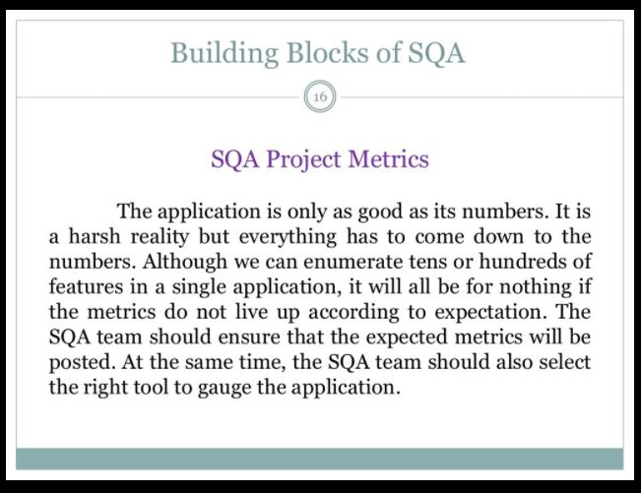

Slide 27
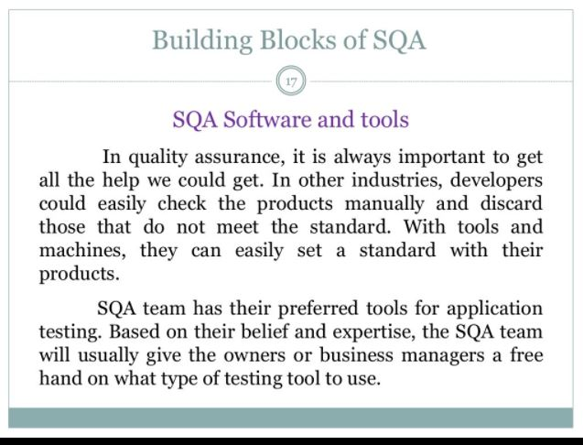

Slide 28
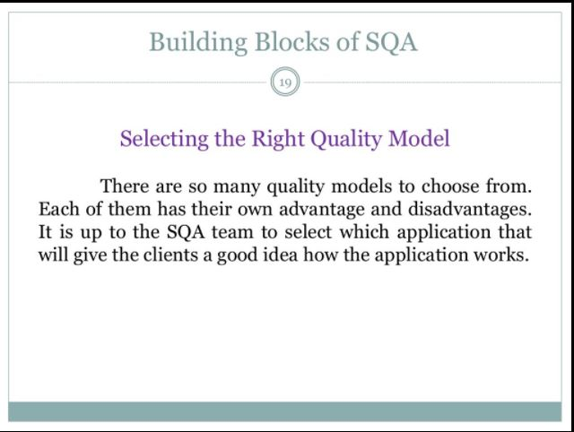

Slide 29
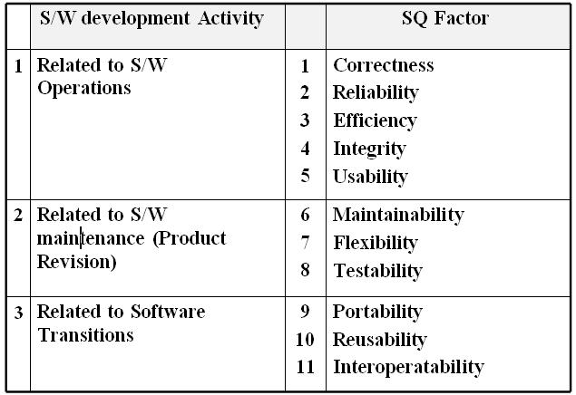
1.5 Software Quality factors:-

Slide 30
Software Quality Factors:
Correctness: Satisfies to customer with respect to objective.
Reliability: the extent to which s/w provides correct result.
Efficiency: Reflects the amount of required resources & code to perform the specified function.
Integrity: Control on unauthorized access to s/w or data.
Usability: the effort required to understand the system i.e. to learn, operate, prepare i/p & interpret o/p.
Maintainability: the effort required to locate & fix bugs in s/w.
Flexibility: the effort required to modify an operational program.
Testability: the effort required to test the program to ensure that it performs its intended function.
Portability: ability of transferring the program from one environment to another.
Reusability: the extent to which a program (or part) can be reused in different applications.
Interoperability: the effort required to couple one system with other

Slide 31
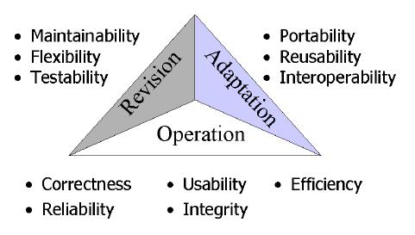

Slide 32
1.6 Software Quality Metrics: Process Metrics & Product Metrics
Software metrics can be classified into three categories −
Product metrics − Describes the characteristics of the product such as size, complexity, design features, performance, and quality level.
Process metrics − These characteristics can be used to improve the development and maintenance activities of the software.
Project metrics − This metrics describe the project characteristics and execution. Examples include the number of software developers, the staffing pattern over the life cycle of the software, cost, schedule, and productivity

Slide 33
Software quality metrics are a subset of software metrics that focus on the quality aspects of the product, process, and project. These are more closely associated with process and product metrics than with project metrics.
Software quality metrics can be further divided into three categories −
Product quality metrics
In-process quality metrics
Maintenance quality metrics

Slide 34
Product Quality Metrics :-
This metrics include the following −
Mean Time to Failure
Defect Density
Customer Problems
Customer Satisfaction

Slide 35
In-process Quality Metrics:-
In-process quality metrics deals with the tracking of defect arrival during formal machine testing for some organizations. This metric includes −
Defect density during machine testing
Defect arrival pattern during machine testing
Phase-based defect removal pattern
Defect removal effectiveness

Slide 36
Maintenance Quality Metrics:-
Although much cannot be done to alter the quality of the product during this phase, following are the fixes that can be carried out to eliminate the defects as soon as possible with excellent fix quality.
Fix backlog and backlog management index
Fix response time and fix responsiveness
Percent delinquent fixes
Fix quality

Slide 37
1.7 Software Reliability & Reliability Measurement Factors:-
Reliability metrics are used to quantitatively expressed the reliability of the software product. The option of which metric is to be used depends upon the type of system to which it applies & the requirements of the application domain.

Slide 38
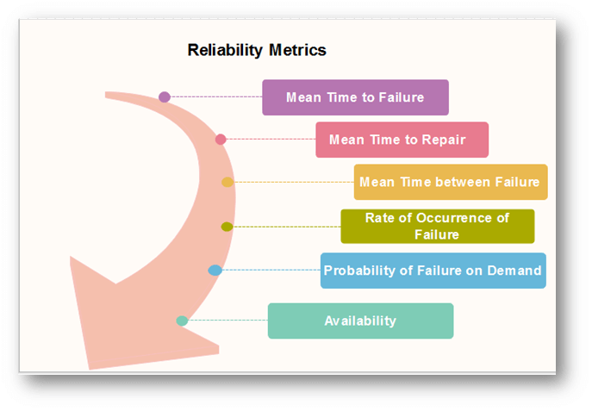

Slide 39
Mean Time to Failure (MTTF):-
MTTF is described as the time interval between the two successive failures. An MTTF of 200 mean that one failure can be expected each 200-time units. The time units are entirely dependent on the system & it can even be stated in the number of transactions. MTTF is consistent for systems with large transactions.
For example, It is suitable for computer-aided design systems where a designer will work on a design for several hours as well as for Word-processor systems.
To measure MTTF, we can evidence the failure data for n failures. Let the failures appear at the time instants t₁,t₂.....t_{n}.

Slide 40
Mean Time to Repair (MTTR) :-
Once failure occurs, some-time is required to fix the error. MTTR measures the average time it takes to track the errors causing the failure and to fix them.
Mean Time Between Failure (MTBR) :-
We can merge MTTF & MTTR metrics to get the MTBF metric.
MTBF = MTTF + MTTR
Thus, an MTBF of 300 denoted that once the failure appears, the next failure is expected to appear only after 300 hours. In this method, the time measurements are real-time & not the execution time as in MTTF.

Slide 41
Rate of occurrence of failure (ROCOF):-
It is the number of failures appearing in a unit time interval. The number of unexpected events over a specific time of operation. ROCOF is the frequency of occurrence with which unexpected role is likely to appear. A ROCOF of 0.02 mean that two failures are likely to occur in each 100 operational time unit steps. It is also called the failure intensity metric.

Slide 42
Probability of Failure on Demand (POFOD):-
POFOD is described as the probability that the system will fail when a service is requested. It is the number of system deficiency given several systems inputs.
POFOD is the possibility that the system will fail when a service request is made.
A POFOD of 0.1 means that one out of ten service requests may fail.POFOD is an essential measure for safety-critical systems. POFOD is relevant for protection systems where services are demanded occasionally.

Slide 43
Availability (AVAIL)
Availability is the probability that the system is applicable for use at a given time. It takes into account the repair time & the restart time for the system. An availability of 0.995 means that in every 1000 time units, the system is feasible to be available for 995 of these. The percentage of time that a system is applicable for use, taking into account planned and unplanned downtime. If a system is down an average of four hours out of 100 hours of operation, its AVAIL is 96%.

Slide 44
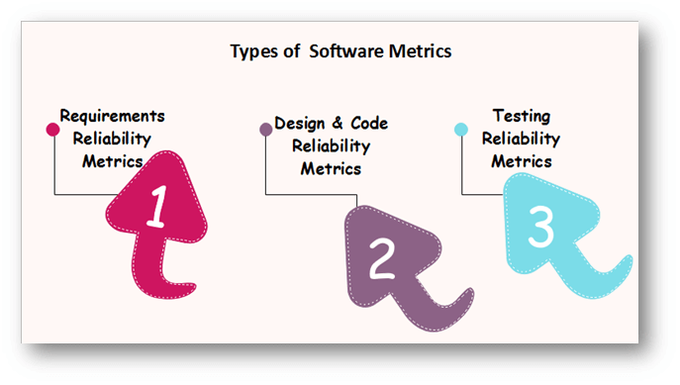

Slide 45
Reliability Measures:
What is reliability?
It is the probability of running a computer program without any failure in a specified environment for a specified time period.
Failure means nonconformance to software requirements (as per software quality & reliability terms)
A simple measure of reliability is MTBF Mean Time Between Failure, where

Slide 46
MTBF = MTTF + MTTR
MTTF: Mean Time To Failure, MTTR: Mean Time To Repair
Reliability is the most costly performance characteristic to assess & most difficult to guarantee.
Software reliability is closely related with software availability.
Availability is the percentage that a program is operating according to requirements at a given point of time.
Software Reliability is the probability of a failure free operation over a specified time in a given environment for a specific purpose.
Software Availability is the probability, that a system, at a point of time will be operational & able to deliver the requested services.

Slide 47
Reliability can be improved by :
1. Fault avoidance
2. Fault Detection & Removal
3. Fault Tolerance

Slide 48
 | Metric | Meaning
1 | POFOD Probability of Failure on Demand | It is the probability that the system will fail when a service request is made. 0.001 POFOD means that out of 1000 service request 1 may result in failure.
2 | ROCOF Rate of Failure Occurrence | The frequency of the occurrence of unexpected behavior. This metric is sometimes called as Failure Intensity. 2/100 means 2 failure occurrence in each 100 operational time units.
3 | MTTF Mean Time To Failure | The average time between observed system failures. An MTTF of 500 means that one failure can be expected in every 500 time unit.
4 | AVAIL Availability | The probability that the system is available for use at a given time. Availability of 0.998 means that in ever 1000 time units the system is likely to be available for 998 of these.

Slide 49
2.2 Reliability models:
Software reliability models are:
1. Calendar time:
The model that predicts reliability w.r.t. calendar time
2. Processing (CPU) time:
The model that predicts reliability w.r.t. processing (CPU) time (actual elapsed time in execution)
3. Quantitative Model:
The model based on the internal characteristics of a program & computes predicted no. of errors.
4. Seeding Model:
This model indicates the software reliability as a measure of the error detection power with a set of test cases.

Slide 50
Various criteria for reliability models are:
Predictive Validity:
The ability of model of predicting the future failure of the system based on the collected test data.
Capability:
The ability of model to generate data that can be readily applied to s/w development efforts.
Quality of assumptions:
Assumptions on which the mathematical foundation of the model is based & the degree of
degradation of model when the assumption limits are over.
Applicability:
The degree to which the reliability model can be applied to different s/w application domains & types.
Simplicity:
It is the degree to which the collected data supports the model straightforward. It also refers as the degree to which the overall approach can be automated.

